Slide 1
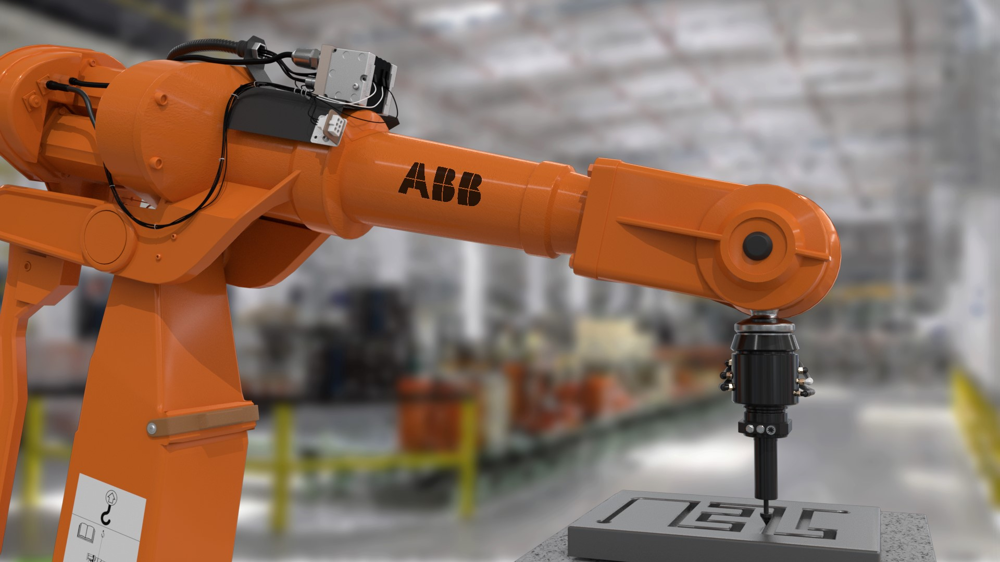
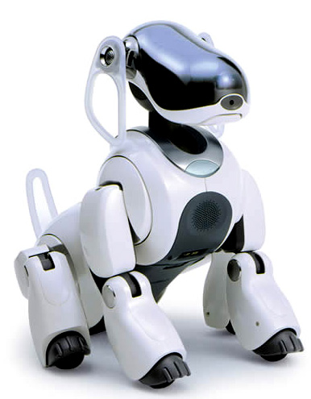
Components and Subsystems
CC0 Sony.com
Notes:
During this lecture the robot are studied as a integration of different subsystems such as mechanical, electrical, sensors, software, process, planning and control.

Slide 2
Robot classification
CC0 Sony.com

Slide 3
Decomposition of a robot system
A robot can be described in different functional subsystems
Software
  Integrates the different subsystems together
Process
  Environment, people, factory etc.
Planning
  Perception, World modelling, Trajectory planning etc.
Control
  Control loops, Process models, Models of mechanics etc
Electrical
  Motors, Computers, Interfaces, Communication links etc.
Mechanical
  Arms, Hands, Links, Joints etc
Sensor (both internal and external)
  Position, Velocity, Vision, Touch etc
Notes:
The robot can be described in different subsystems depending on the viewers background.
The software integrates the subsystems together to one unit. The robot. This is done, as discussed last time both on-line and off-line.
Process information includes the knowledge about the process e.g. welding parameters. But also knowledge about the environment
Planning subsystem includes the information about the modelling, perception and planning. In the modelling process information from the sensors are integrated with mathematic models to from a model of the world. This model are used by the perception system to select the right strategy which are converted into robot programs during the planning process.
Control subsystem, high-level commands are converted to reference values and used for control of the robot
Electrical subsystem are retrieved signals from the control system and uses actuator to move the robot. This subsystem includes also motor, computers and interfaces.
Mechanical subsystem affects the environment. This subsystem includes all mechanical parts.
Sensor subsystem sends information back from the environment and can be used in the control subsystem.

Slide 4
Vocabulary
Forward kinematics: mathematical relationship which determines the tool coordinate system
Inverse kinematics: mathematical relationship which determines the values of the joint coordinates based on the values of the tool coordinate system
Pose: combination of position and orientation in space

Slide 5
Vocabulary
World coordinate system: stationary coordinate system referenced to earth which is independent of the robot motion
Base coordinate system: coordinate system referenced to as the base mounting surface
Joint coordinate system: coordinate system referenced to the joint axes, the joint coordinates of which are defined relative to the preceding joint coordinates or to some other coordinate system
Tool coordinate system, TCS: coordinate system referenced to the tool or to the end effector attached to the mechanical interface

Slide 6
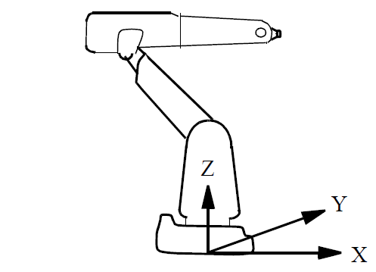
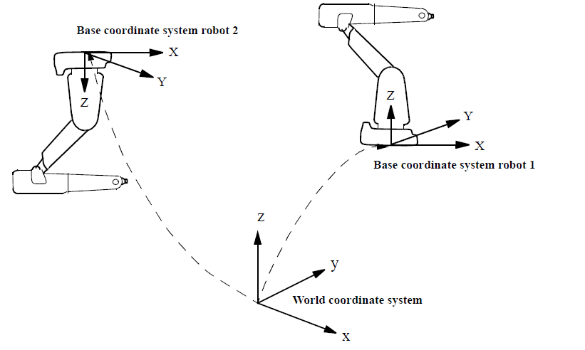
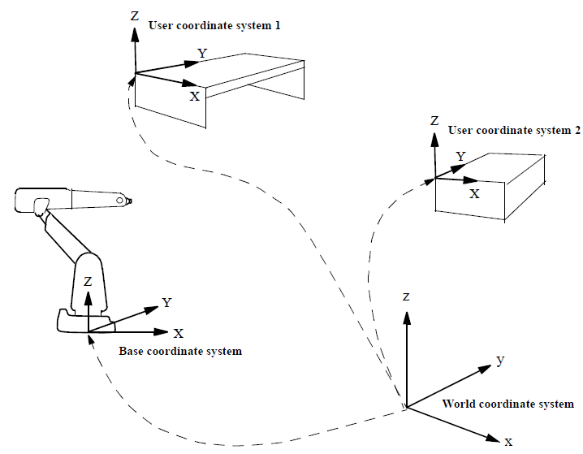
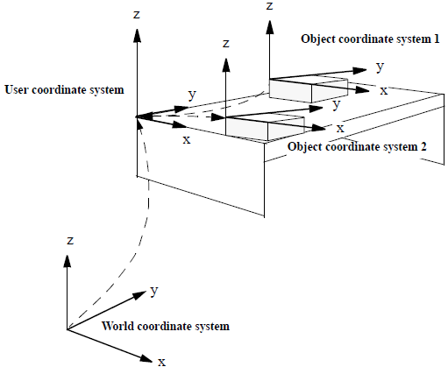
Remember Coordinate system
World coordinate system
Base coordinate system
Object coorinate system (wobj)
User object coorinate system (fixturs)

Slide 7
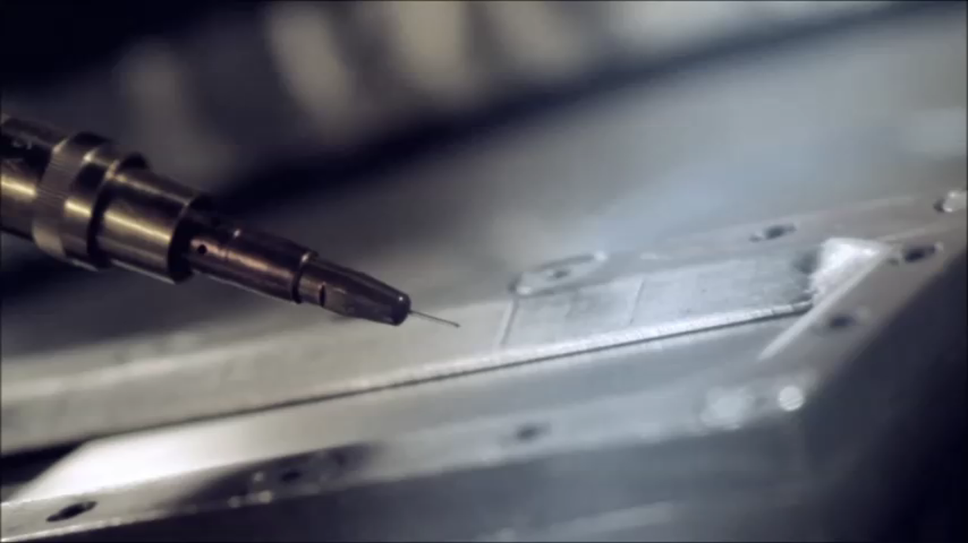
Robot characteristics
Payload
  The weight the robot can carry and still remain within its other specifications
Reach
  Maximum distance a robot within its work envelope
Precision (validity)
  How accurate a specific point can be reached
Repeatability
  How accurate the same position can be reached if the motion is repeated many times

Slide 8
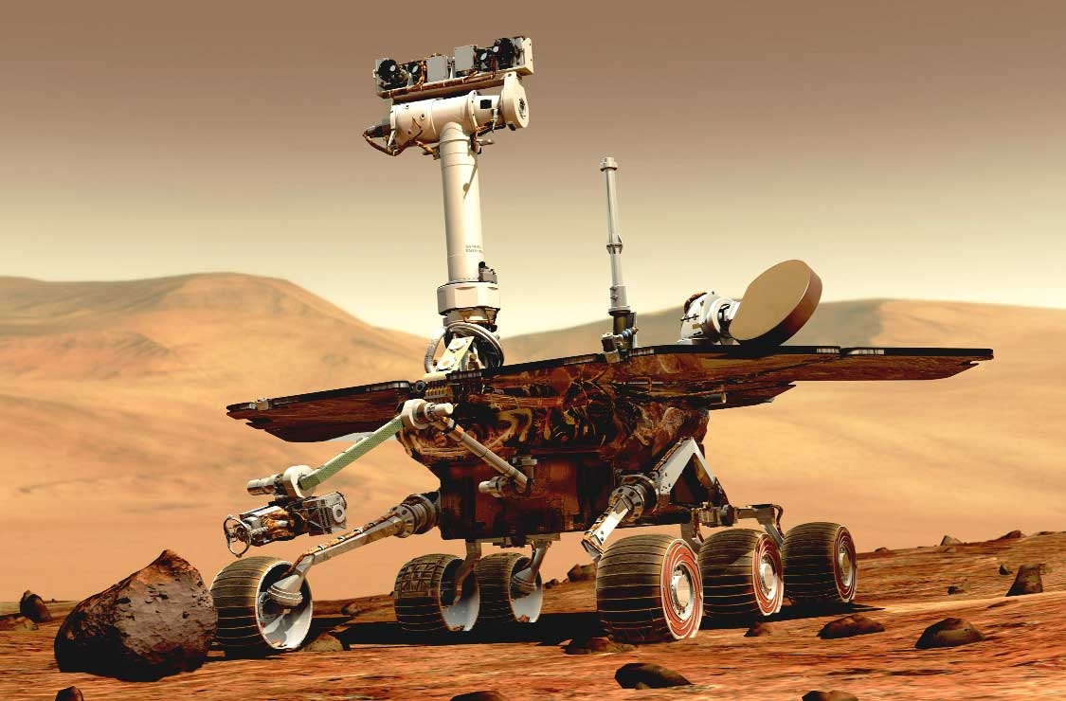
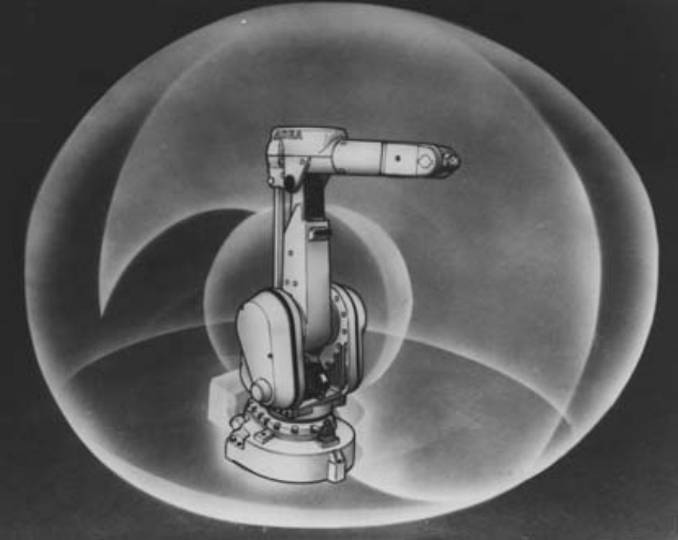
Robot characteristics
Working space: space which can be swept by the wrist refernce point added by the moving range of the rotation or translation of each joint in the wrist.
Maximum space includes the space swept by the robot including end effector and workpiece;
Restricted space is the maximum space restriced by limiting devices;
Operational space is the restricted space actually used by a task program
Tool center point (TCP): point defined for a given application with regard to the mechancial interface coordinate system

Slide 10
Robot classification – mobile robots
CC0 Sony.com
Notes:
During this lecture the robot are studied as a integration of different subsystems such as mechanical, electrical, sensors, software, process, planning and control.

Slide 11
Mobile robots classification
The environment in which they travel:
  Land or home robots. They are most commonly wheeled, but also include legged robots with two or more legs (humanoid, or resembling animals or insects).
  Aerial robots are usually referred to as Unmanned Aerial Vehicles (UAVs)
  Underwater robots are usually called autonomous underwater vehicles (AUVs)
The device they use to move, mainly:
  Legged robot : human-like legs (i.e. an android) or animal-like legs.
  Wheeled robot.
  Tracks.

Slide 12
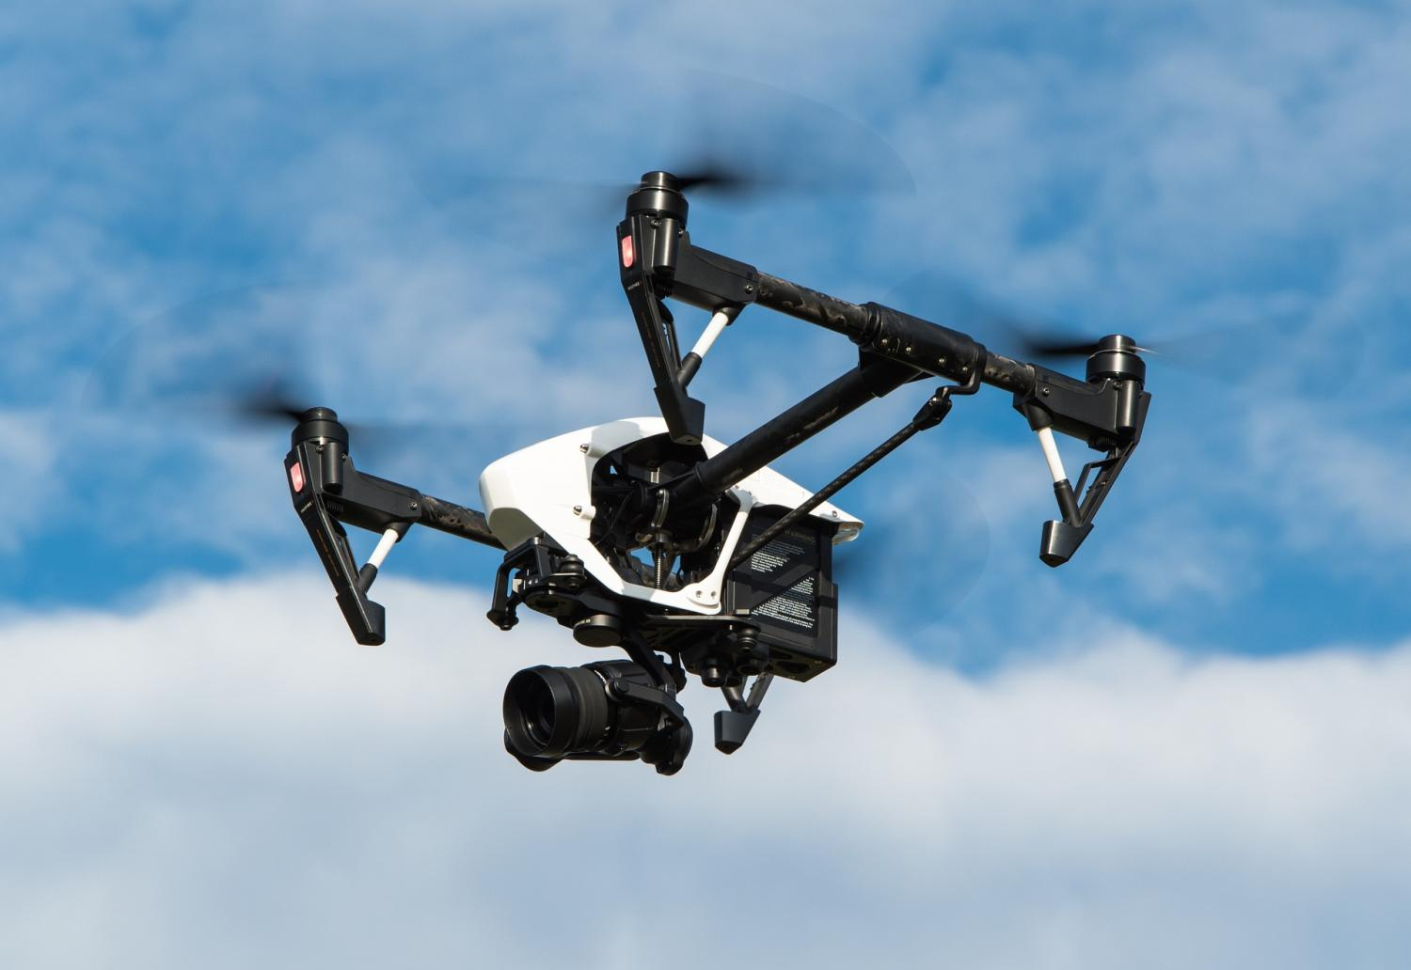
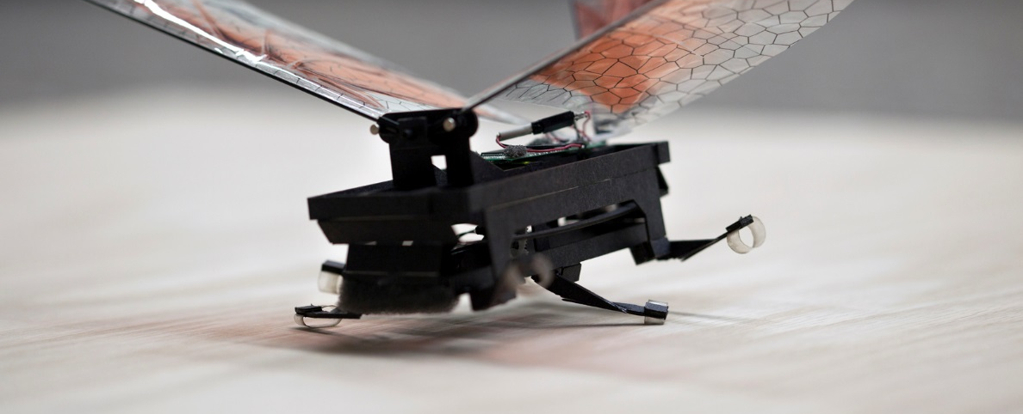
From flying insects to large objects
Interesting area which are increasing more and more!
Wide range of applications

Slide 13
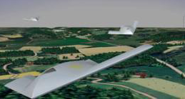
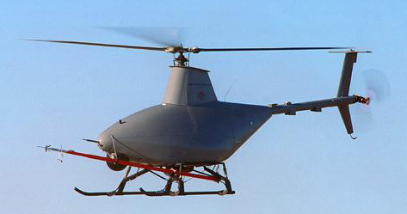
Flying (semi) autonomous vehicles (UAV) or Drone
UAVs provide public benefits for a variety of
applications
  Film production
  Disaster Response, forest fire
  Homeland Security/Law Enforcement
  Traffic monitoring
  Communication Relay
  Inspection of coffee plantations, winery forests, and fields
  Coast Guard
Military operations raised awareness
  Utilized successfully in recent conflicts, Kosovo, Afghanistan,
  Ukraine
Current federal air regulations did not anticipate operations of controlled unmanned aircrafts in civil airspace

Slide 14
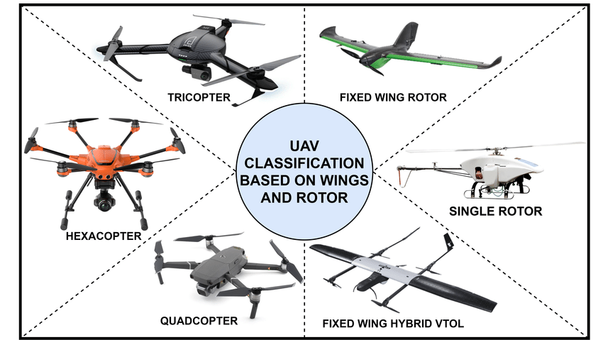

Slide 15
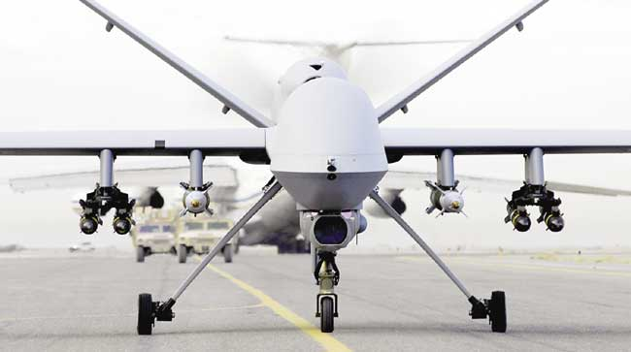
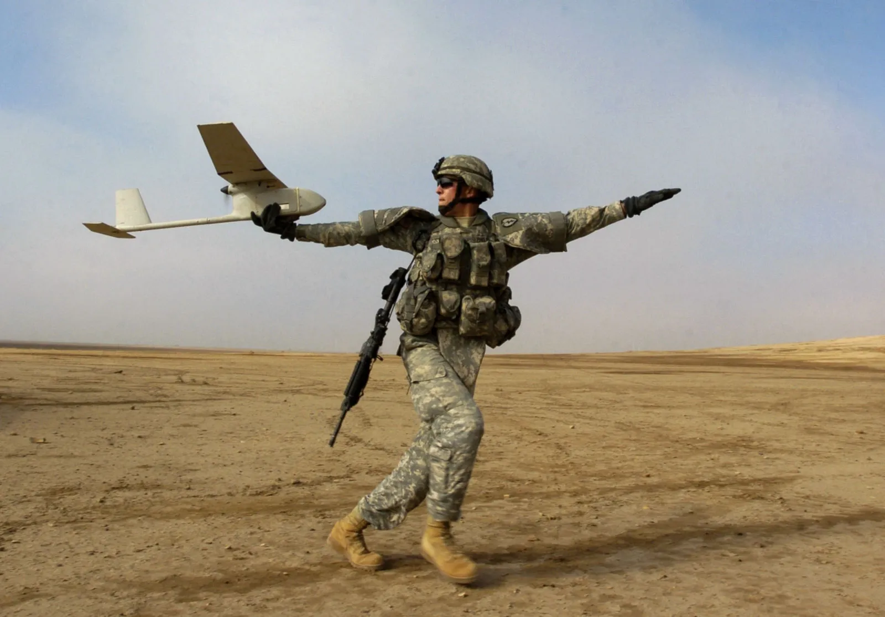
UAVs military applications

Slide 16
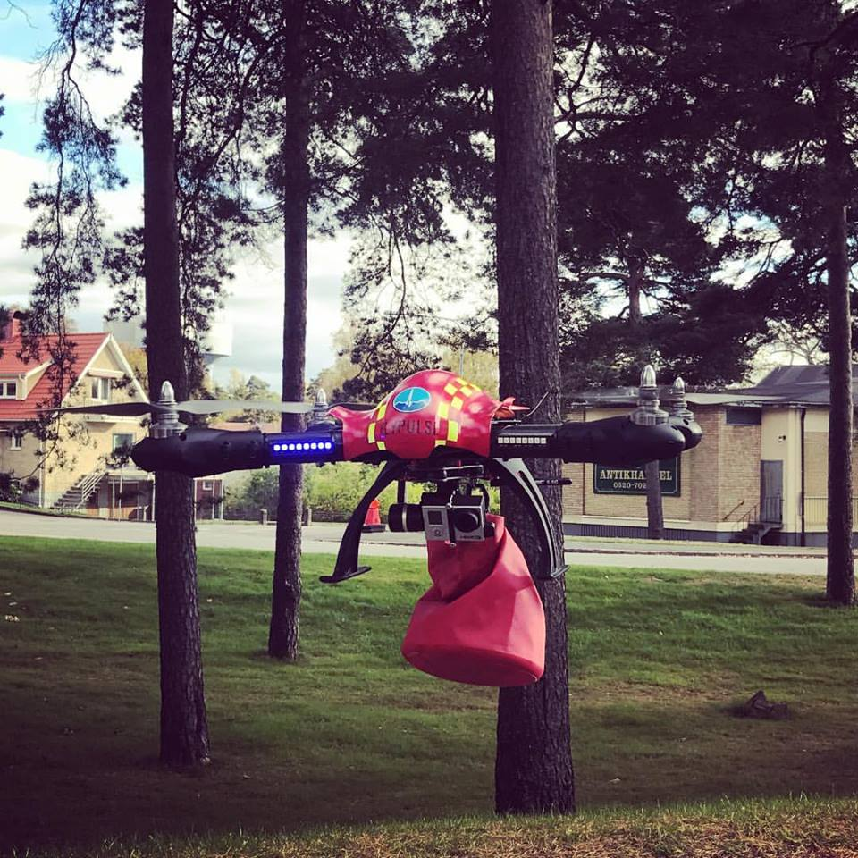
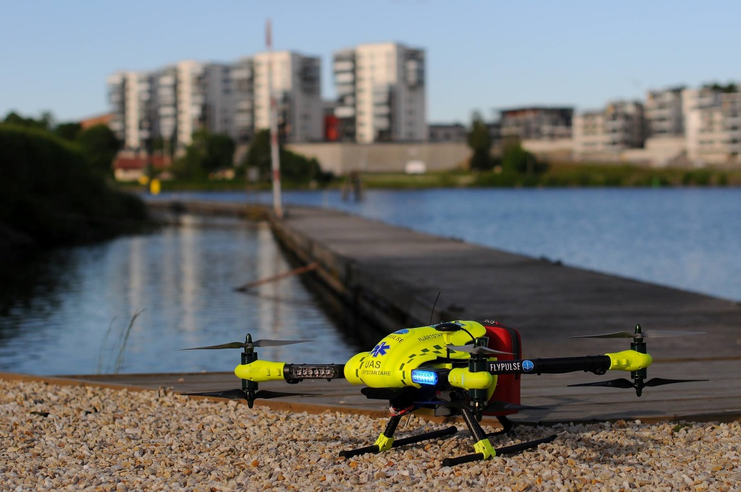
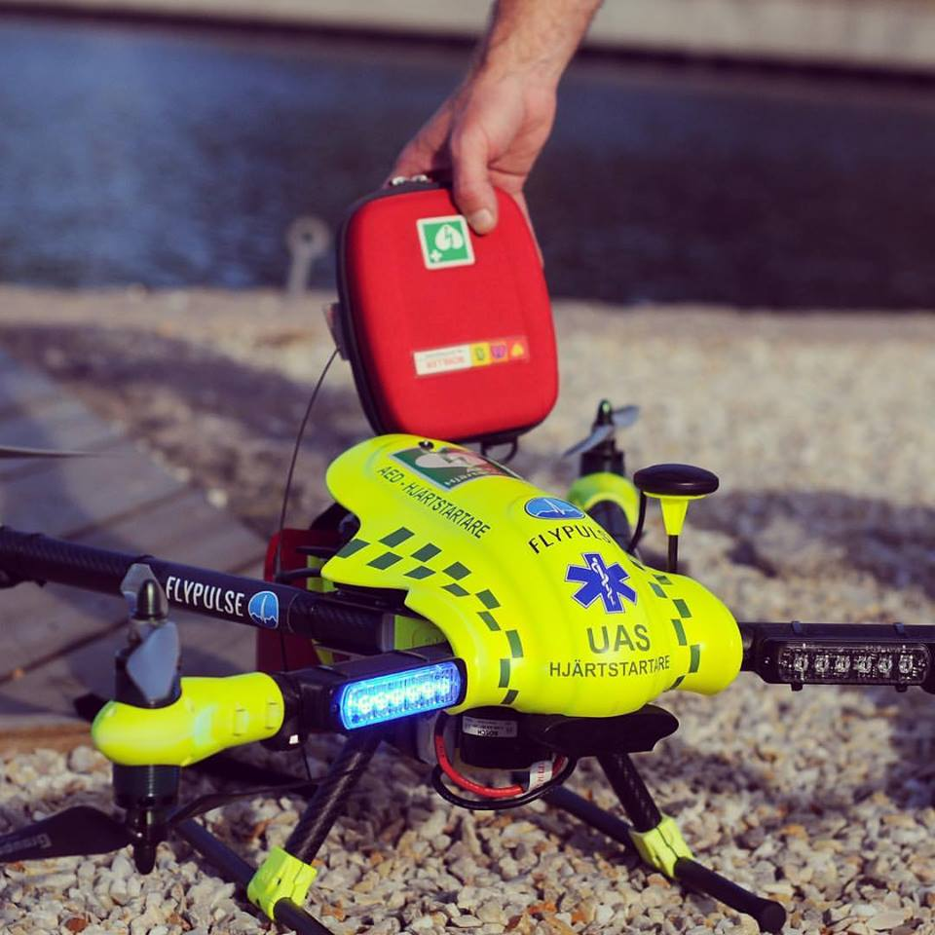
Example on ongoing research/development @ Innovatum

Slide 17

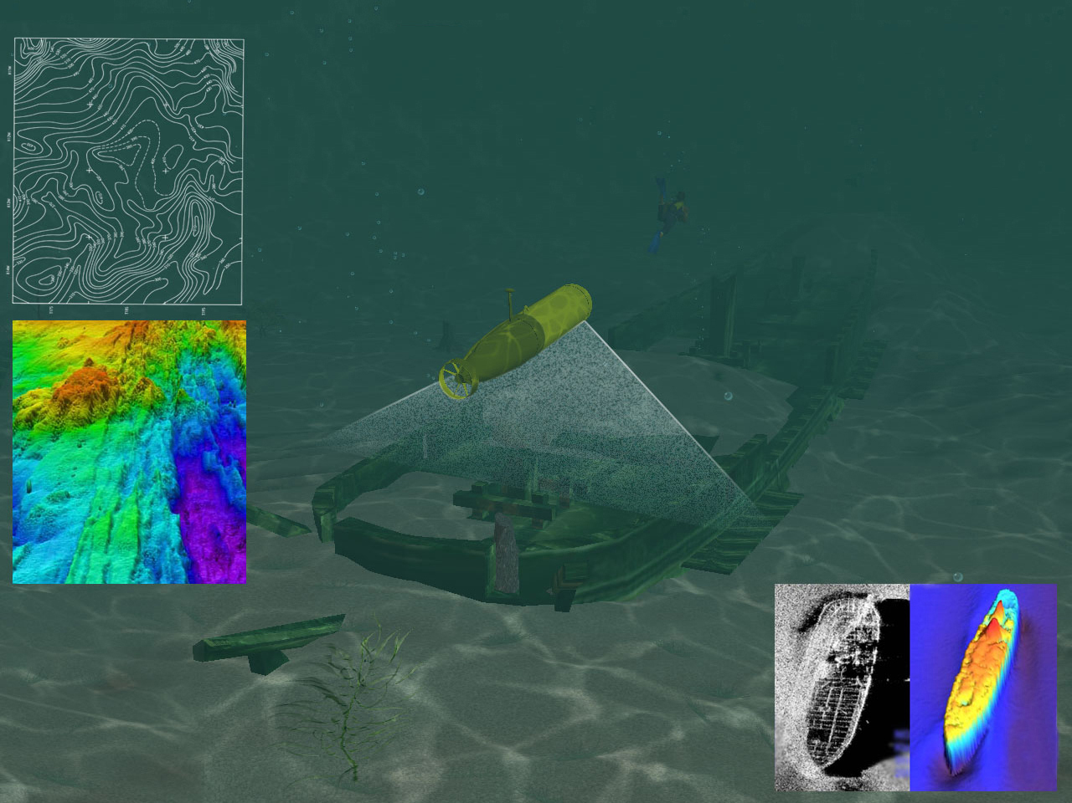
Underwater Rovers
http://www.noaa.gov/
https://www.ted.com/talks/david_lang_my_underwater_robot

Slide 18
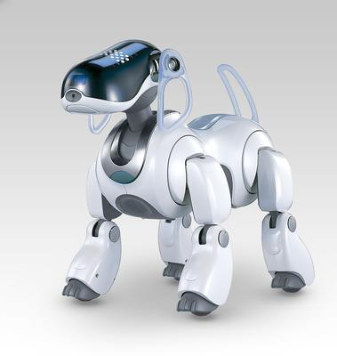
Movability for a robot
Industrial solution
  robots are fixed in position
  One robot can manage several machines (FMS)
  Materials handling by conveyers or AGVs
Outside industry
  Wheeled vehicles
  Legged vehicles
Notes:
Two different approaches exits inside the manufacturing industry and out side (research, space etc). The industry solves the movaility by locating several machines around the robot (flexible manufacturing systems, FMS). Components are transported between the different workcells with either conveyers or by automated guided vehicles (AGV).
Outside the industry, robots with either legs and wheels exist. Legs are more a research question. But have been introduced to the public the last years. Examples are small dogs from Sony.
Wheels have been a popular transmission system for mobile robots. The same principle As for cars has been used.

Slide 19
Wheeled Vehicles
Why wheels
  Advantages
    Simple to control
    Faster than legs
    Less energy per unit
    Good stability
  Disadvantages
    Smooth and solid terrain
    Climbing in stairs

Slide 20
Wheeled Vehicles
Layout
One or Two wheels
  Stability problems
Three wheels
  Solves the stability problem
  and turning problem
Four wheels (Car)
  Problems to turn
More than four wheels
  More ruff terrain
Tracked vehicle
  Damage environment
Spirit – Mars -03,
Courtesy NASA/JPL-Caltech.
Notes:
Car can have back-wheel drive, front wheel drive and all wheel drive. Problem accurse in turns the inside wheel rotates with a different speed compared with the out side wheel. To solve this problem a suspension system has to be used.
This type of vehicles have a problem in manoeuvrability because they have to have a forward motion in order to turn
Three wheels reduces the problem with suspension ie wheel to ground contact can be maintained all the time. If the driving and steering wheel are the same is a more complex mechanical design. Small errors can easily results in a large derivation from the true path in a few meters.

Slide 21
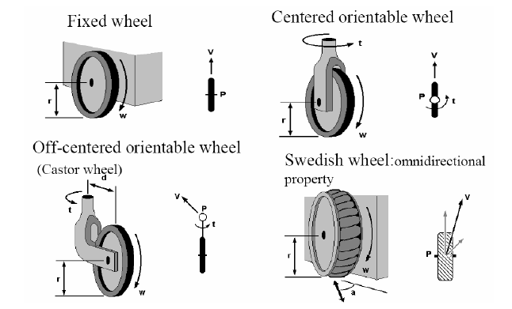
Different wheel types

Slide 22
Wheeled Vehicles
Five basic types of wheel configuration for a robot with three wheels
Omnidirectional
Differential
Omni steer
Tricycle
Two steer

Slide 23
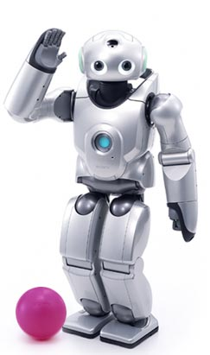
Legged Vehicle
Advantages
  Step over obstacles
  Walk up and down stairs
  Step over trenches
  Smooth ride over rough surface
  Less damaged on the surface
Disadvantages
  Construction
  Balance
  Controlling
Sony QRIO, sony.com

Slide 24

Legged Vehicle
Static stability
  Three feet on the ground
  Centre of gravity within this three feet
Dynamic stability (human like)
  Moving body or feet to maintain centre of gravity

Slide 25
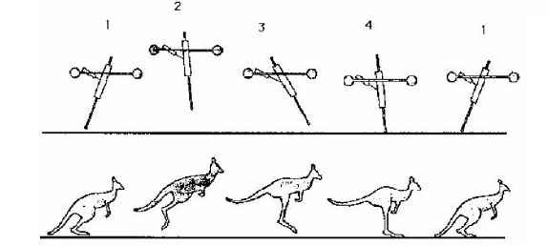
One legged jumper
Parameters that can be measured
  Hip angle
  Leg extension
  Foot on ground
Parameter that can be controlled
  Hip angle
  Leg thrust

Slide 26
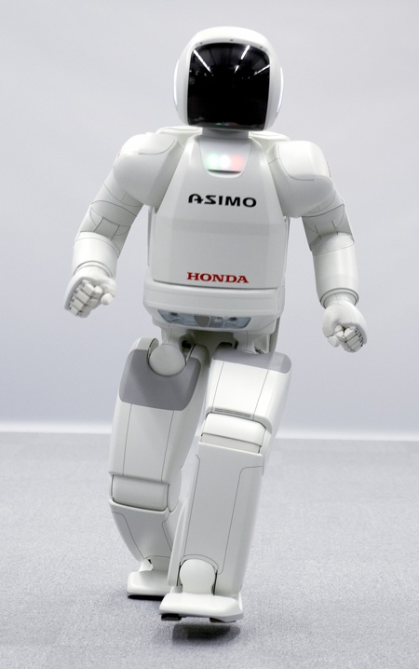
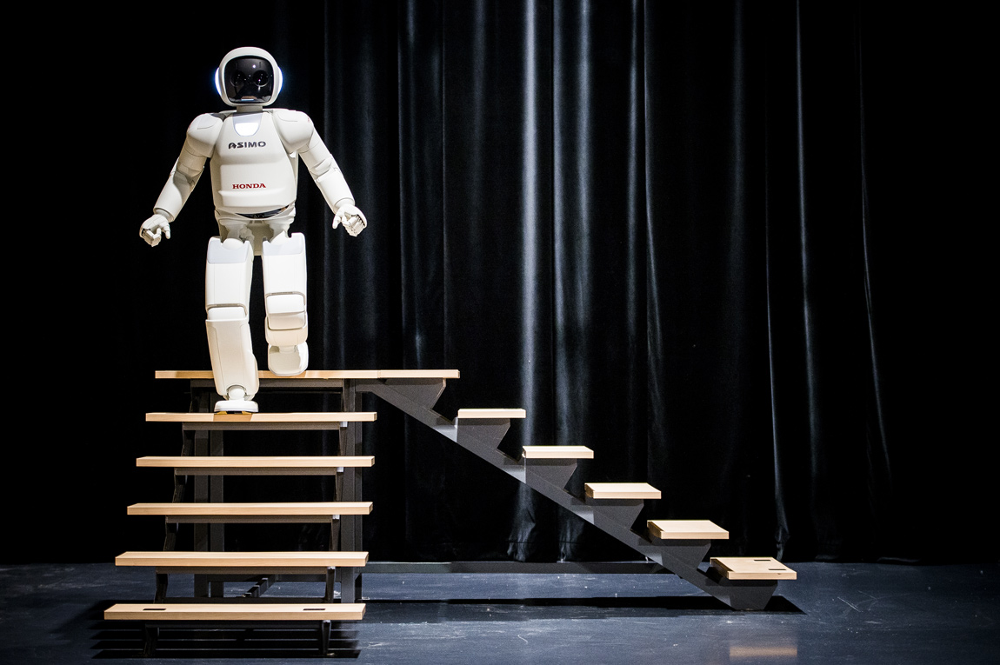
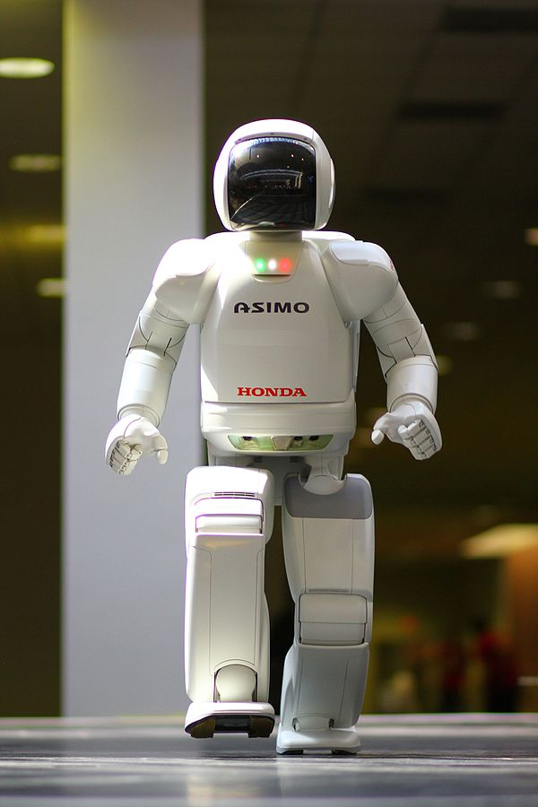
Honda Asimo – 20 years
https://vimeo.com/101276186
Notes:
Created 2000. Production stop 2018
CC0

Slide 28
Robot design – Manipulator arm
CC0 Sony.com
Notes:
During this lecture the robot are studied as a integration of different subsystems such as mechanical, electrical, sensors, software, process, planning and control.

Slide 29

Manipulator Arm
Copy of the human evolution, called articulated arm
Increased flexibility, less degree of freedom
Classified depending on the combination of joints
Consists of
  Vehicle
  Arm
  Wrist

Slide 30
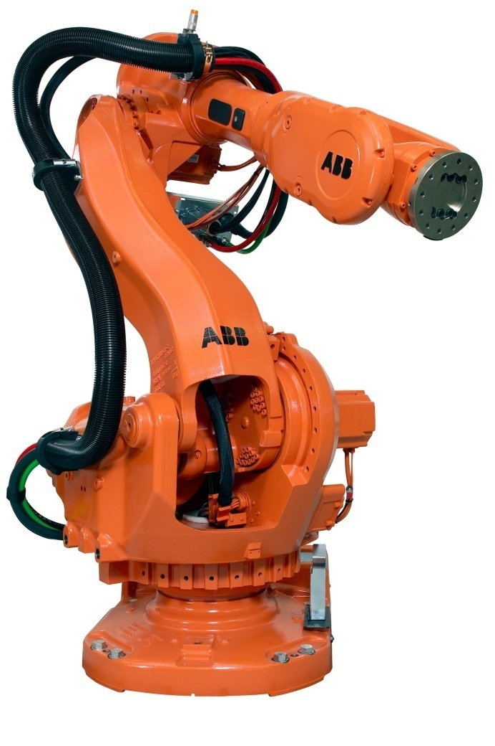
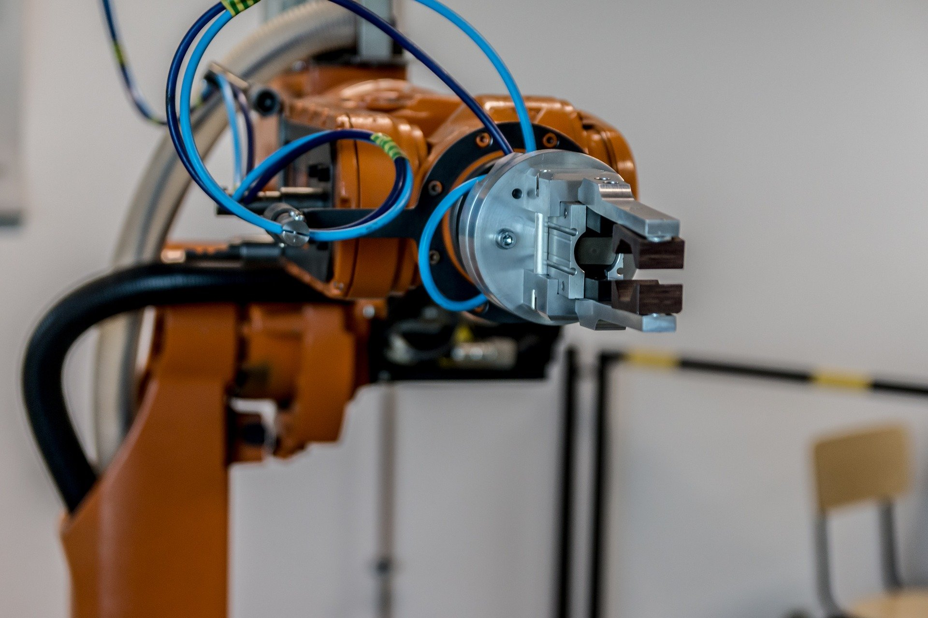
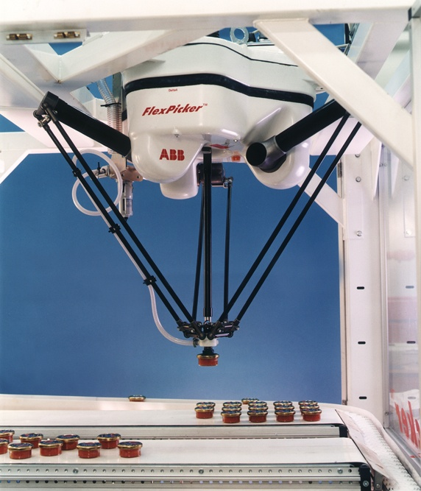
Manipulator Arm
CC0 Public Domain
https://www.youtube.com/watch?v=vyEvkHXFg_Y
https://www.youtube.com/watch?v=aPTd8XDZOEk
http://www.youtube.com/watch?v=v9oeOYMRvuQ&feature=related

Slide 31
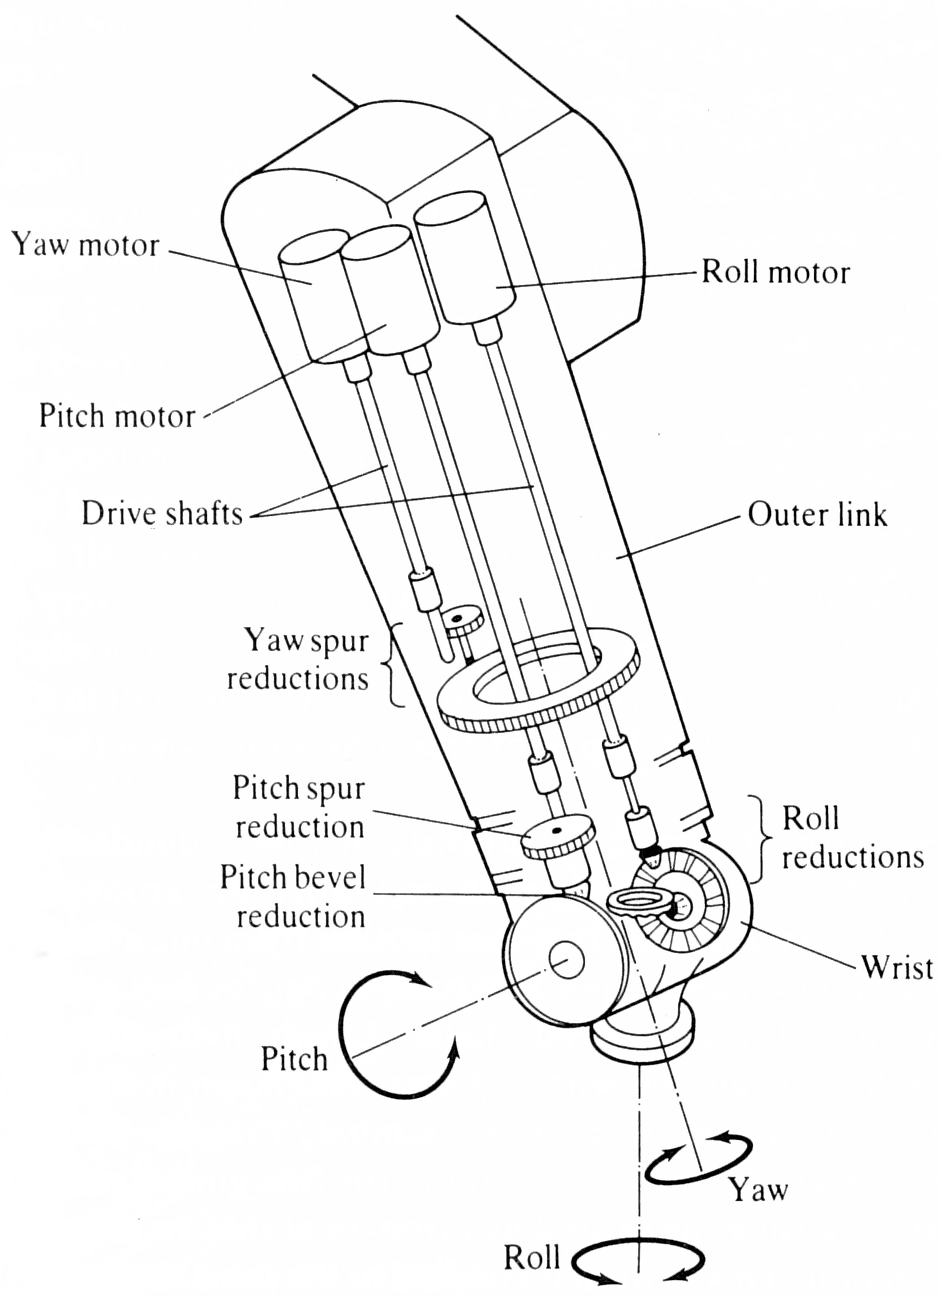
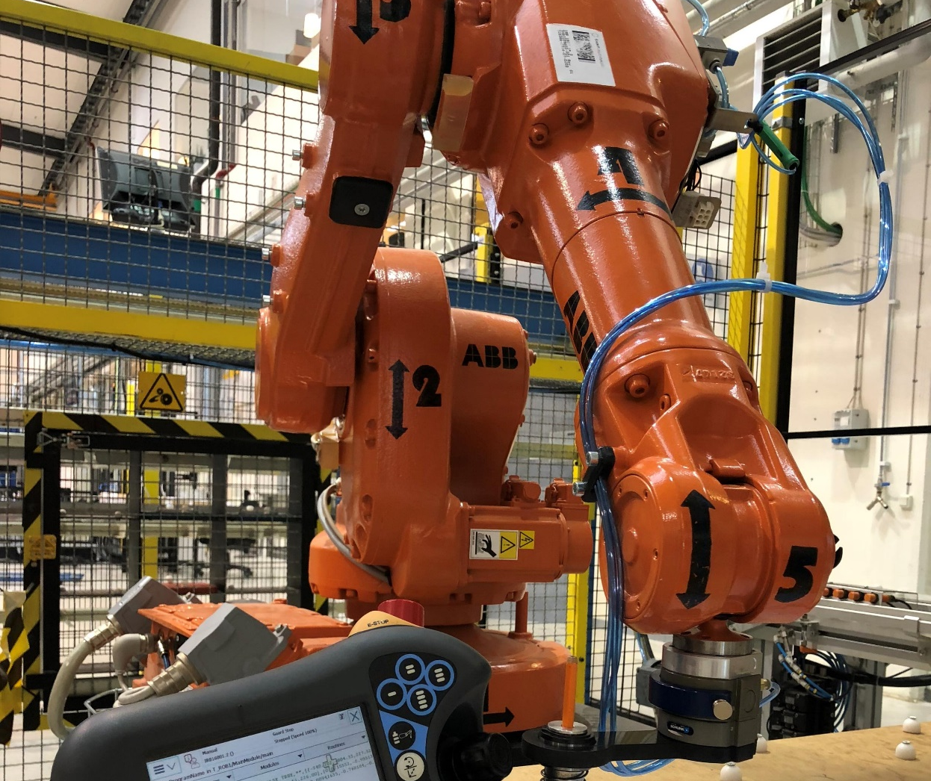
Construction of robot arm
CC0 Public Domain

Slide 32
Coordinates
Different references for coordinates
  Motor (pulses within the motors)
  Joint (angles between the links)
  World (reference to the environment)
  Tool (according to the tool plate)
  Work object (according to the working object)

Slide 33
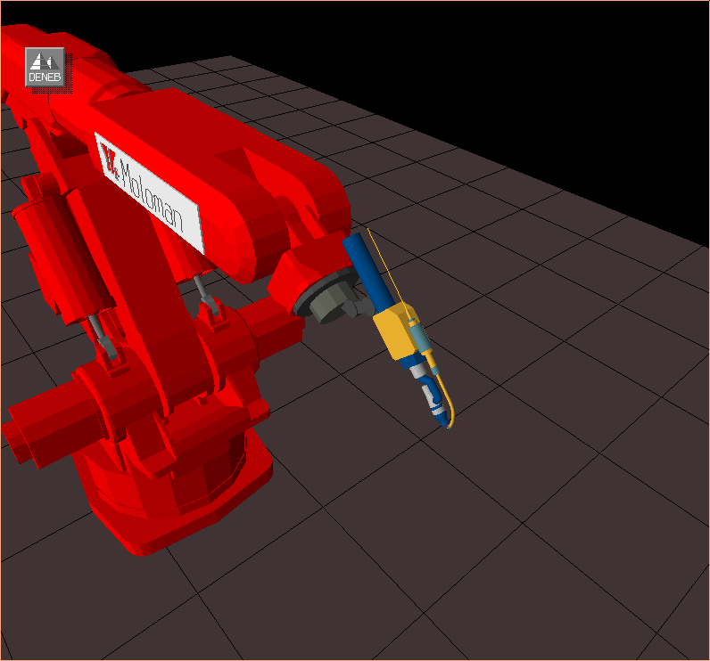
Wrists
Three degrees of freedom
Nautical terms
  Yaw x-direction
  Pitch y-direction
  Roll z-direction
Z in the working direction
4
5
Pitch
6
Yaw
Roll

Slide 34
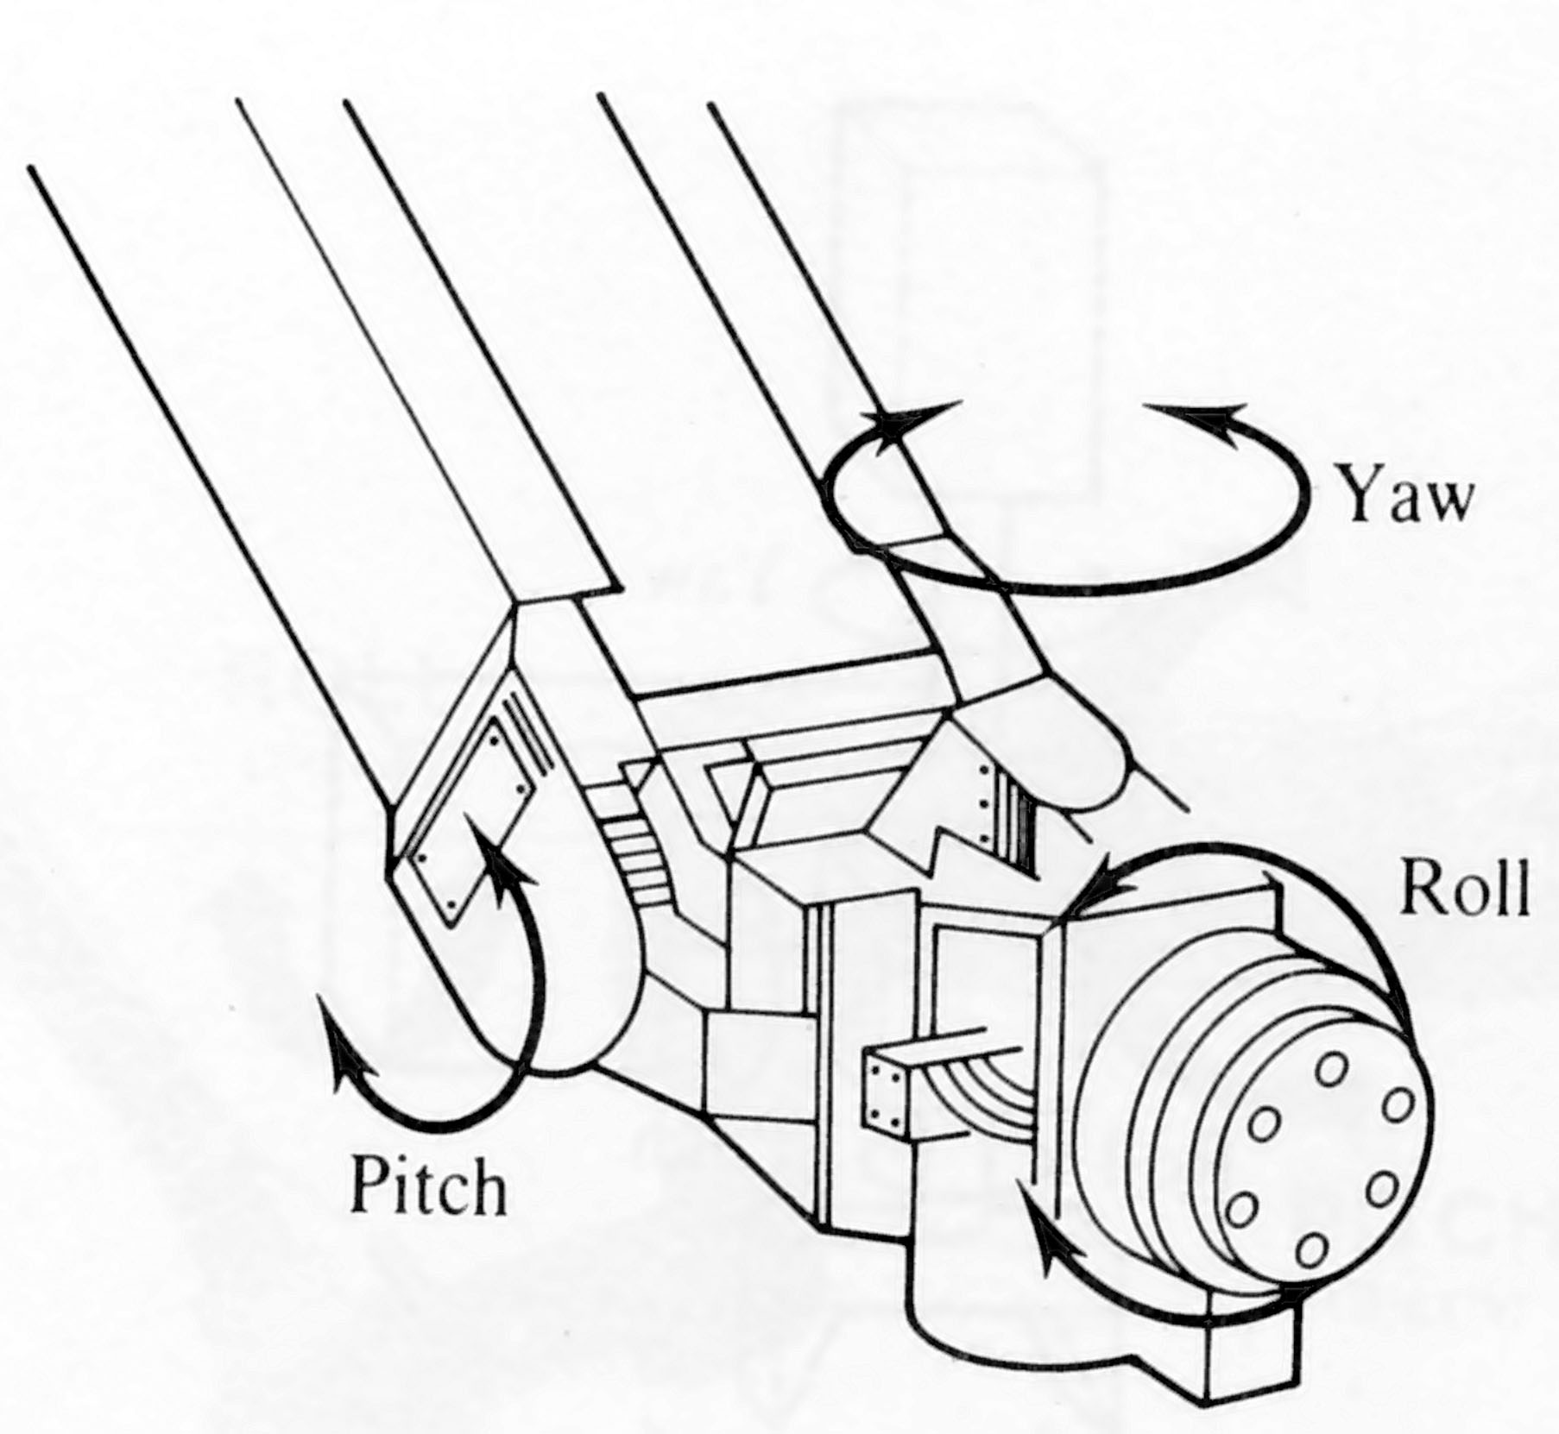
Wrists
CC0 Public Domain

Slide 35
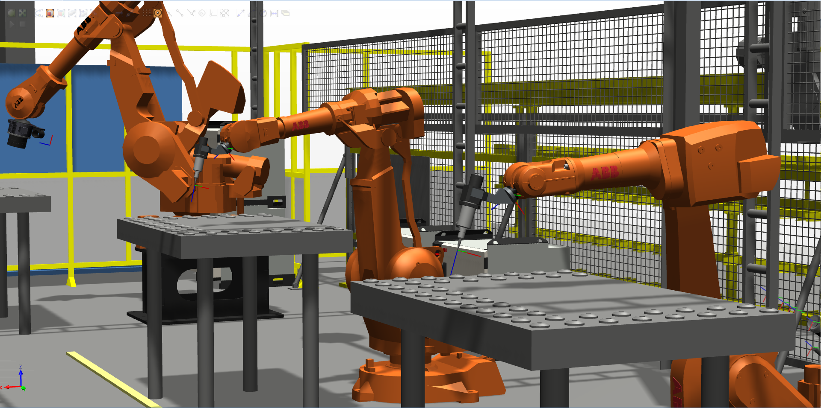
End effectors
Human hand is the optimal end effectors
  Eight different muscles only for the thumb
Industry
  Special design to fit a special task
Research
  Imitate the human hand

Slide 36

Industry end effectors
End effectors is everything which is mounted at the end of the last joint
Three groups
  Tool exchange system
  Tools, such as weld gun
  Gripper
    Mechanical
    Vacuum
    Magnetic

Slide 37
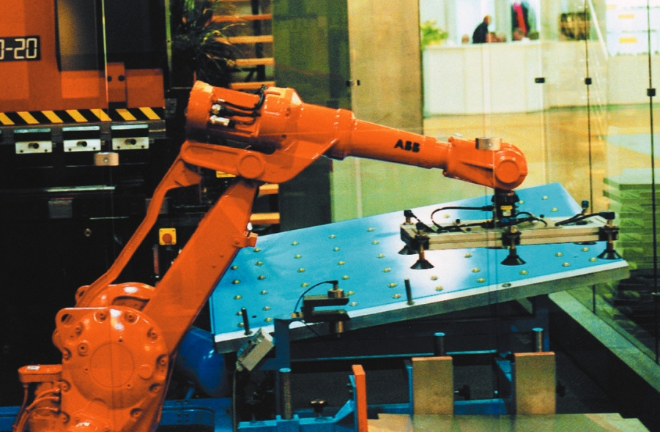
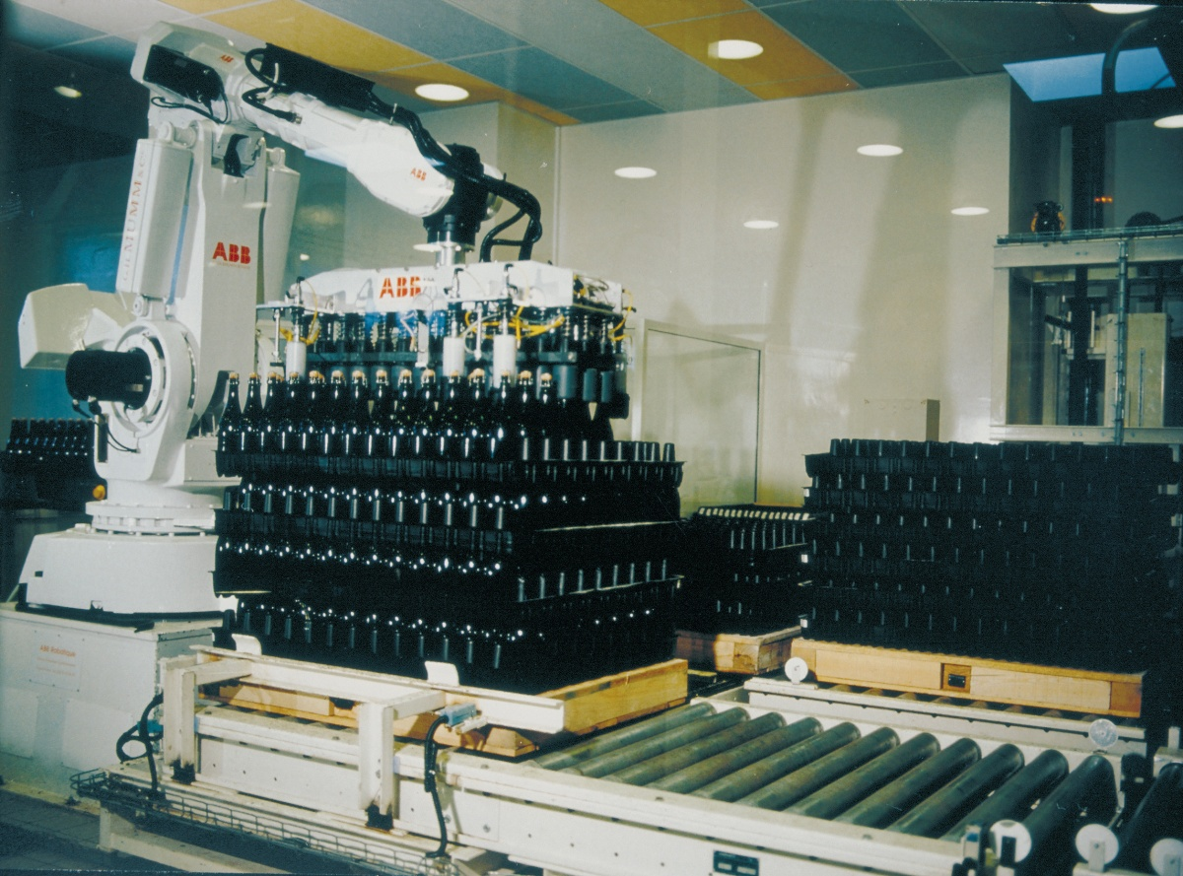
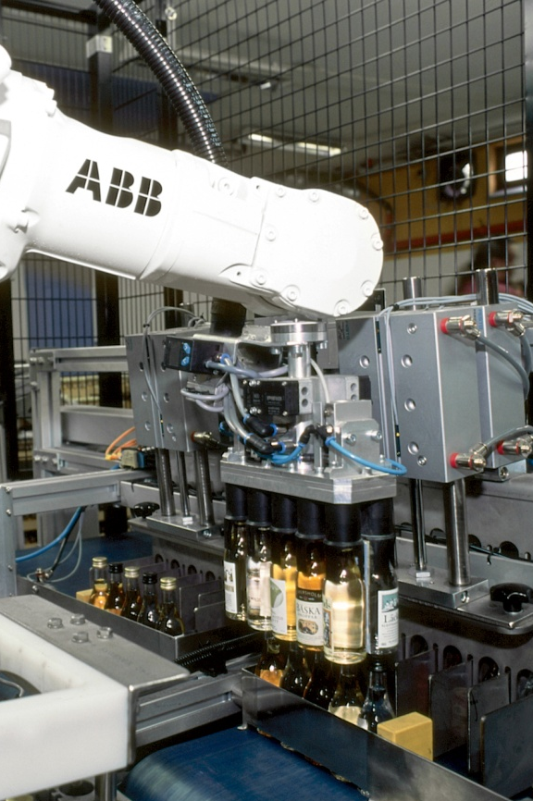
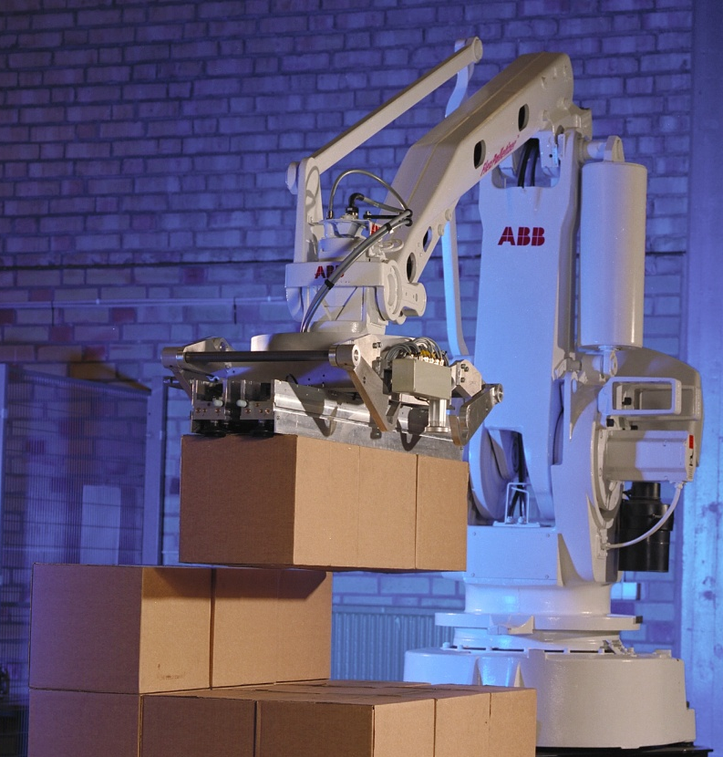
Industry end effectors
Notes:
Wikimedia commons

Slide 38

Tool exchange systems

Slide 39
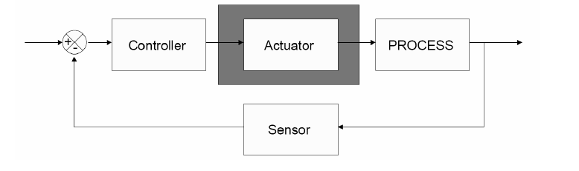
Actuators
Actuator converts the command signal from controllers or higher-level components into physical adjustment in adjustable process variable

Slide 40
Actuators
Actuators are the mechanism to create motion
Power to move
  Electrical, hydraulic and pneumatic
  Environmental conditions
  Mechanical capabilities
Electrical most common
  Stepper motor
    Rotation generated by pulses
  DC motors

Slide 41
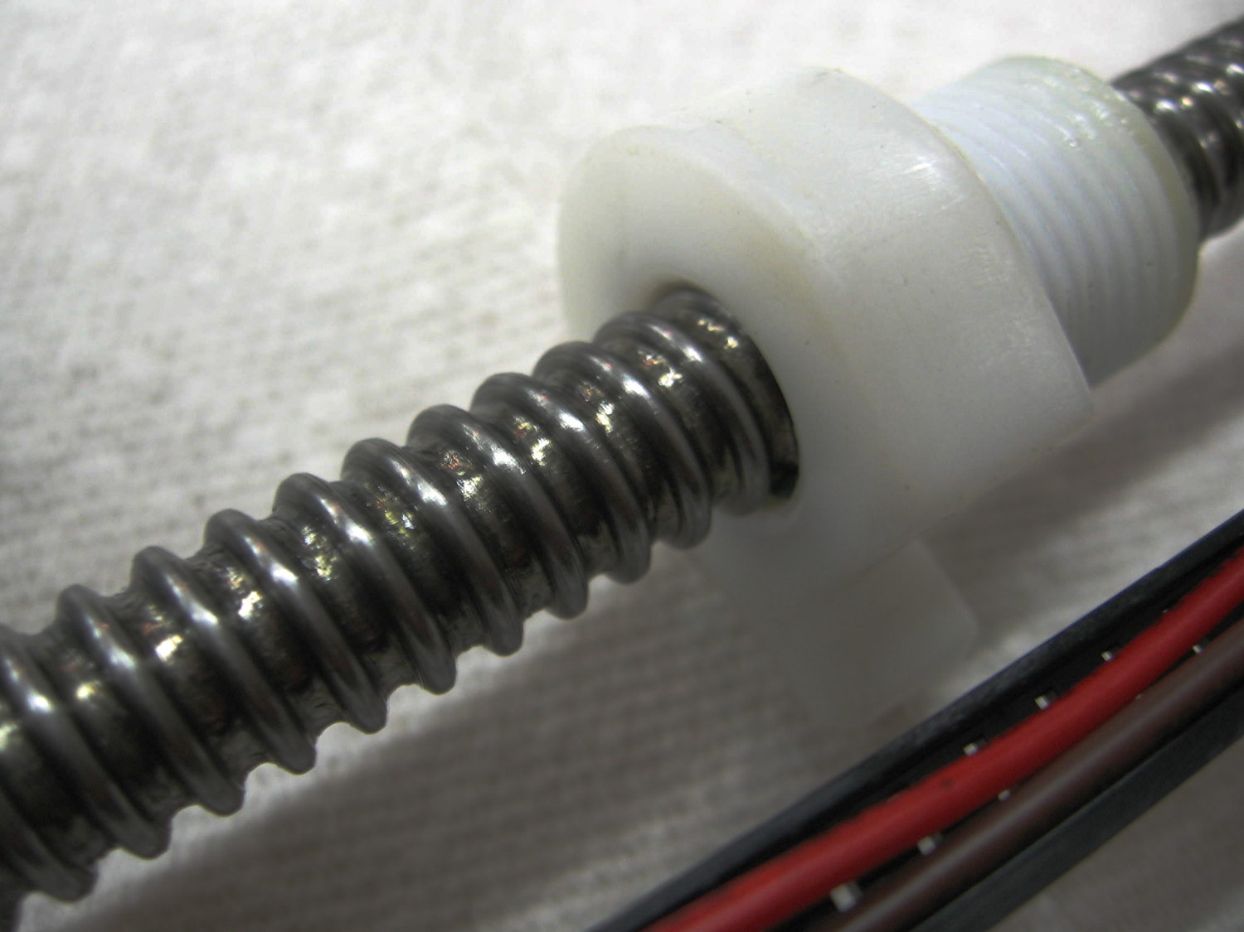
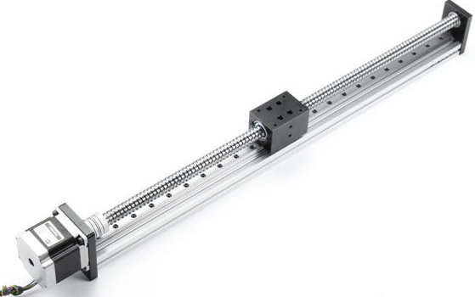
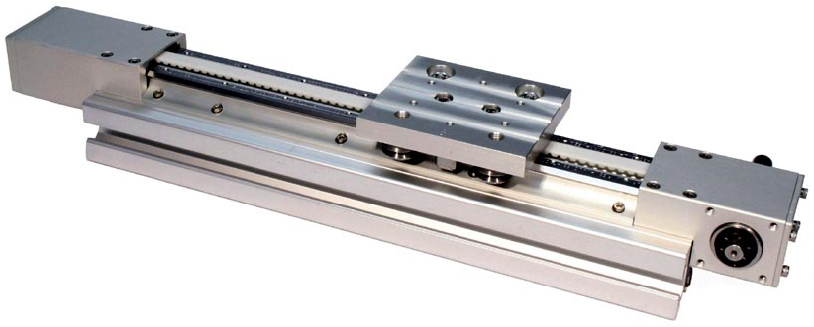
Linear Actuators - examples
Wikimedia commons

Slide 42
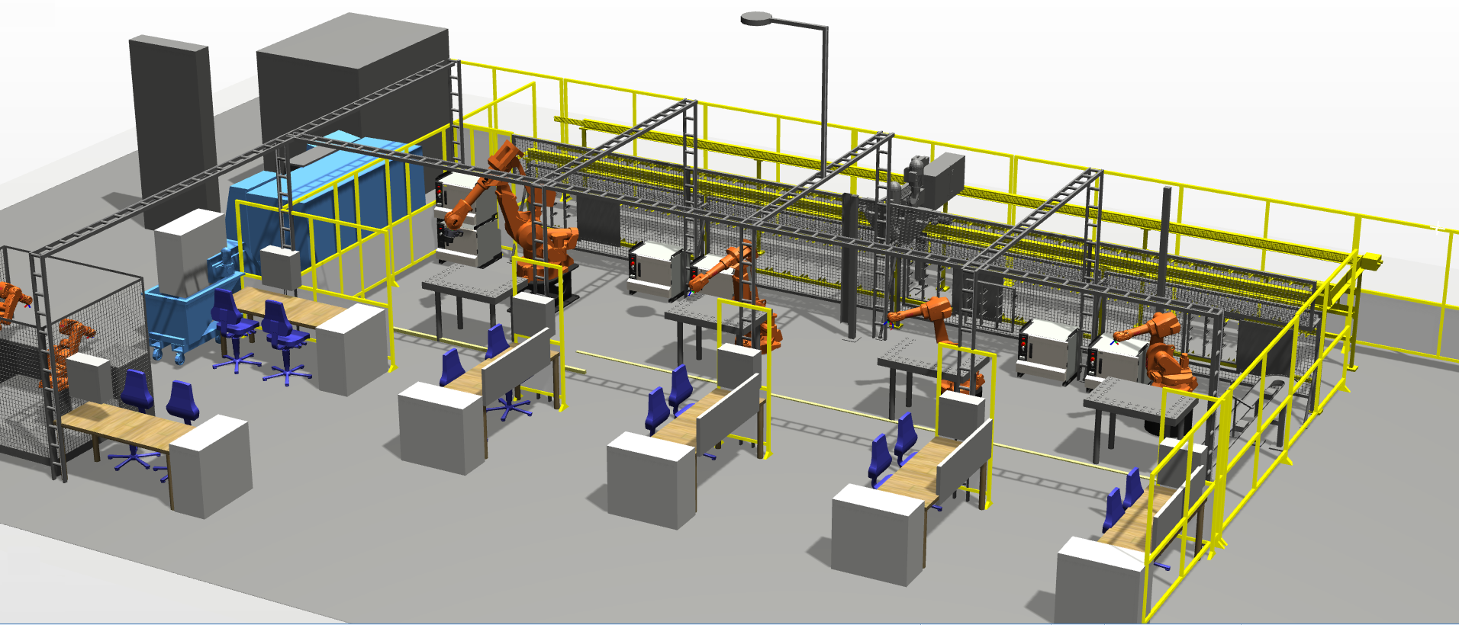
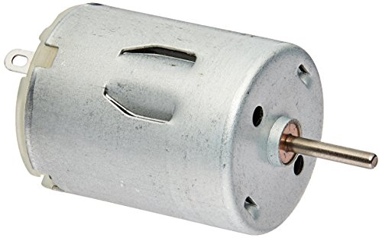
Electrical motors
Electromagnetic direct current (DC) motors
  Usually runs high speed and low torque
Electromagnetic alternating (AC) motors
  More controlling required
Wikimedia commons

Slide 43


Batteries
Parameters to observe
  Rechargeability
  Energy Density
  Capacity
  Voltage
  Internal Resistance
  Discharge Rate
  Shelf Life
  Temperature Dependence
Regulators to keep voltage constant
Wikimedia commons

Slide 44
Transmission Elements
Gears
  Most common
Tendons
  Used for remote of the power from the actuator
  Wires
  Chains
Linkage
  Stiff construction compared with tendons
Disadvantages
  Poor dynamic response
  Difficult to achieve fine movements
  Additional mechanics are needed

Slide 45
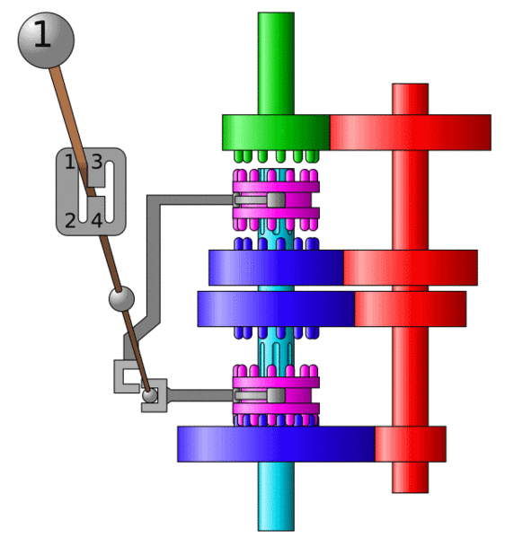
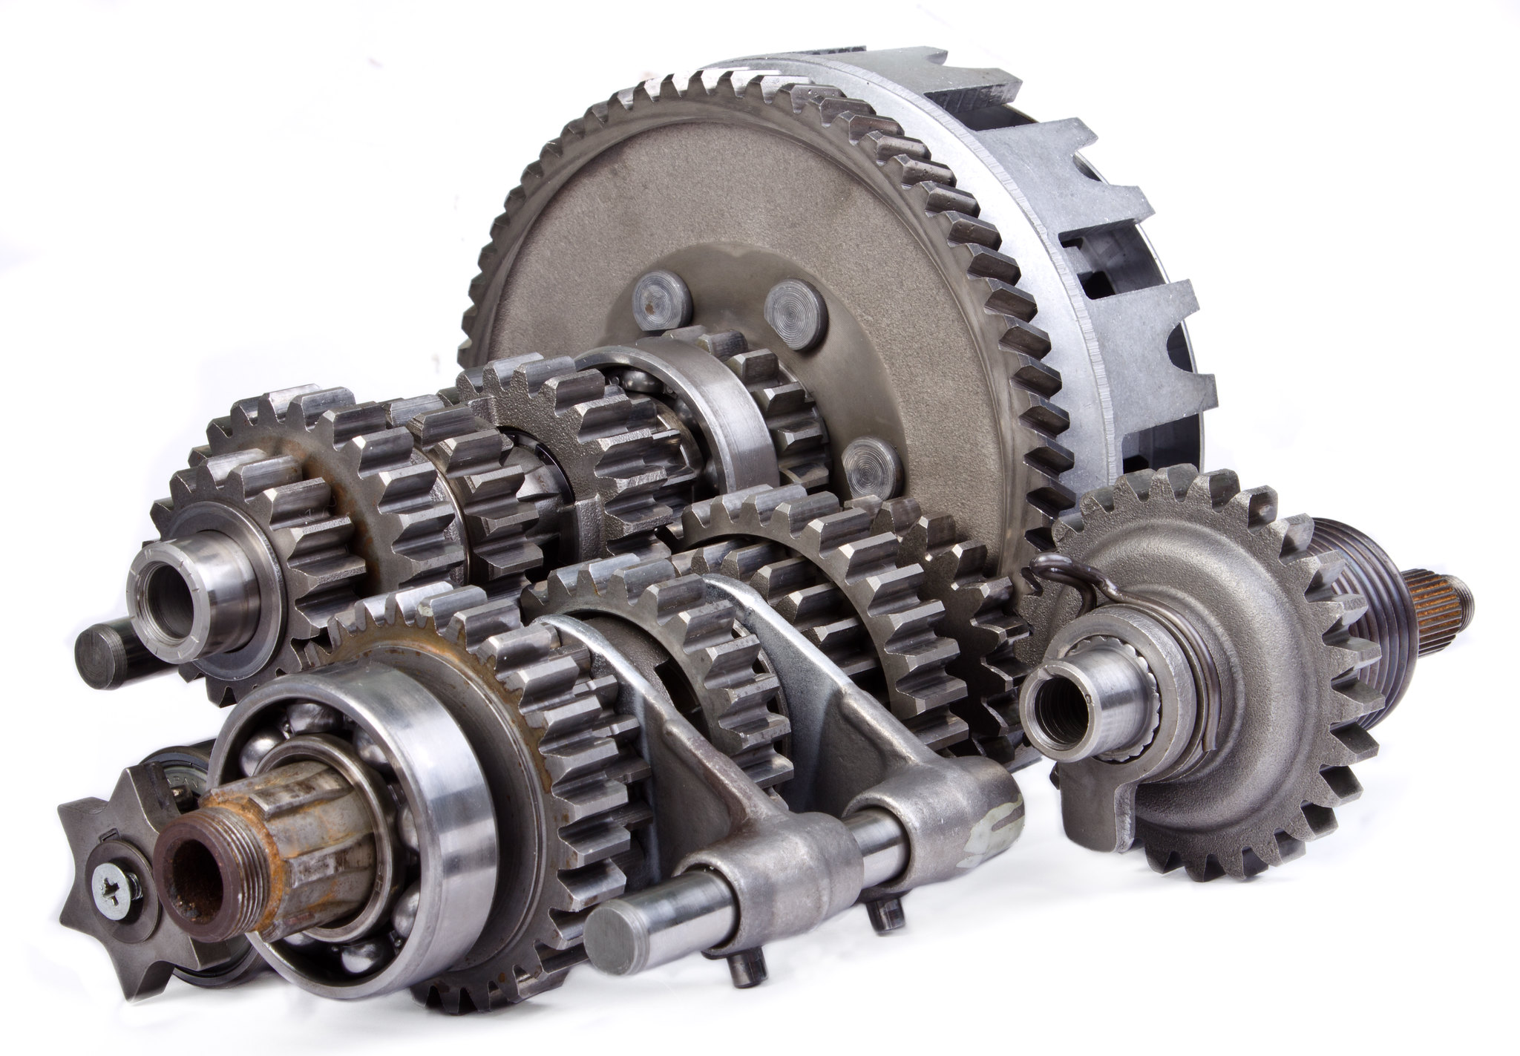
Gearbox
Increase/ decrease rotation speed.
https://www.flickr.com/photos/burgerfeet/6135487397

Slide 46
Sensors
Internal
  Joint angle
  Wrist force
External (Environment)
  Range
  Vision
  Voice

Slide 47
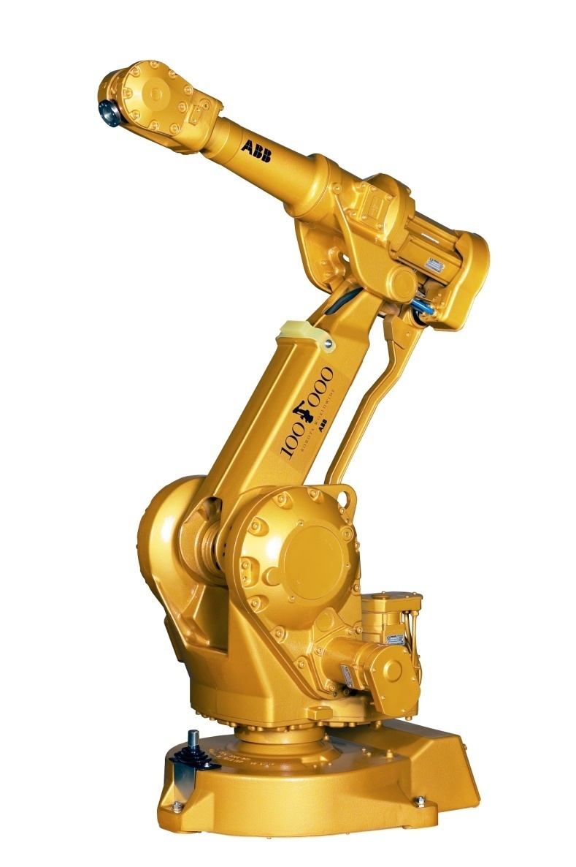
Materials
Demands
  Steel and aluminium are most common
  Composite (light)
  Application dependent

